Slide 1

March 30, 2023
Quarterly Meeting

Slide 2
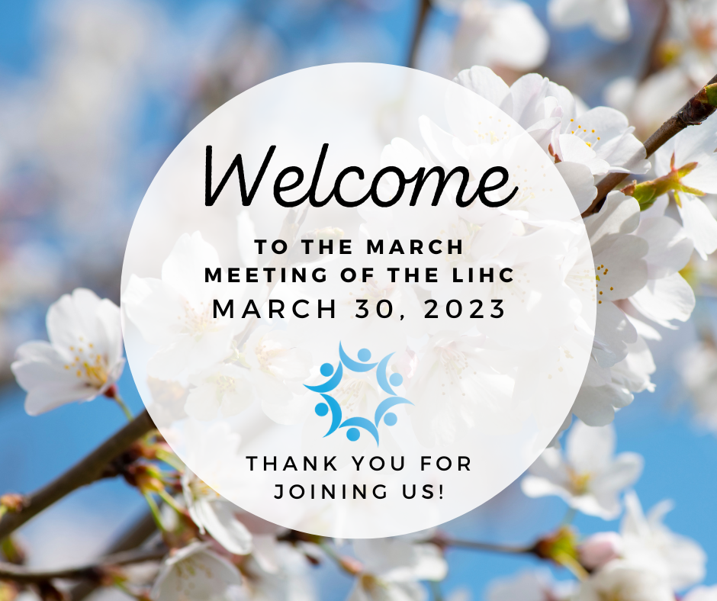

Welcome & Introductions
Thank you for joining us!
Please introduce yourself and tell the group what organization you are representing.
Notes:
For those in person, please go around the room. If you’re attending virtually, please introduce yourself in the chat.

Slide 3
LIHC Updates
2022 Community Health Assessment Survey (CHAS) Analysis
Available on LIHC website
  Summary report
  Full analysis (Excel PowerPivot; tutorial also on LIHC website)
  Press release
  Copies of summary report and accompanying press release are available on back table (in-person) or linked in the meeting agenda (virtual) you received via email

Slide 4


Featured Presentation
Jaci Clement
CEO & Executive Director
Fair Media Council
www.fairmediacouncil.org
Notes:
Jaci is a media guru. She’s an international expert on media, particularly the Long Island media market. Take it away, Jaci!

Slide 5
LIHC Updates Continued
Library Research Project Published
Understanding how suburban public librarians respond to the health and social needs of communities
Published in Library & Information Science Research, Volume 45,
Issue 1, January 2023, 101217
  Congratulations! Amy Hammock, Gabriella Pandolfelli, Tonya Samuel, Pascale Fils-Aimé, Madison Grande, Matthew D'Ambrosion, Mickayla Murphy, Simran Kaur, Janine Logan, Rachel Feuerstein-Simon, Carolyn Cannuscio, Lisa Benz Scott
  Copies of report and accompanying press release are available on back table (in-person) or linked in the meeting agenda (virtual) you received via email
Notes:
A prime example of the power of collaboration
2 colleges, numerous public libraries, LIHC, state funding for transcription of taped interviews
A body of research available for your use
What was uncovered here also dovetails with our CHAS findings, mental health rises to the top

Slide 6
LIHC Updates Continued
Core Clusters
Many thanks to Dorothy Henderson, NSHC/LIHC Intern!
14 responses so far, top five topics of interest:
  Adult mental health
  Obesity
  Physical activity
  Food security / Hunger / Nutrition
  Maternal Health
Next steps:
  Survey to close in 1 week
  LIHC to set up meetings and brainstorm sessions based on survey feedback

Slide 7
LIHC Updates
Community Service Society (CSS)
Keep New York Covered (KNYC) Grant
Continuous Medicaid enrollment ends March 31, 2023.
Provision was part of federal Public Health Emergency (PHE) designation. PHE ends 5/11.
Consolidated Appropriations Act of 2023 decoupled Medicaid continuous enrollment from the PHE
Hence, starting April 1, states can resume Medicaid disenrollments
All Medicaid recipients must re-certify in order to maintain coverage
NSHC part of massive outreach enrollment re-certification effort spearheaded by CSS
Notes:
You all work with many Medicaid recipients
I’m sure you already know about this, but we will be doing a massive outreach through all channels you can think of
It will be continuous
We will send information and call on CBOs to help spread the word

Slide 8
Ongoing Engagement
Collaborative Communications
Bi-weekly email newsletter to 400+ contacts
Submit your free events, resources, jobs, and more to boliveri@nshc.org
Subscribe to Collaborative Communications
LIHC Events Calendar
Submit your events here
Walk with a Doc / Walk Safe with a Doc
Opportunity to partner
LIHC handles coordination, just asks for your efforts to co-promote

Slide 9
Ongoing Engagement
AARP-Sponsored Talk with a Doc 2023
Select Wednesdays in April, May, and June at 11 AM via Zoom
All information and registration links online
  Stress & Your Health: April 12 feat. Dr. Lawrence M. Ferber of Catholic Health
  Parkinson's Disease: April 26 feat. Dr. Guy Schwartz of Stony Brook Medicine
  Skin Cancer: May 10 feat. Dr. Keasha S. Guerrier of Northwell Health
  Fitness for Longevity: May 24 feat. Dr. Shazaan Hushmendy of Mount Sinai South Nassau
  Migraine & Headache: June 7 feat. Dr. Bruce Mayerson of Catholic Health
  Cataracts & Eye Health: June 21 feat. Dr. Jules Winokur of Northwell Health
Notes:
Thank you to everyone who helped us secure physciains, it was no small feat so thank you

Slide 10
Ongoing Engagement
AARP-Sponsored Walk with a Doc 2023
In-person walking events on Saturdays in late April, May, and June
All information and registration links online
  WWAD Babylon: Saturday, April 29 at 11 AM at Argyle Park in Babylon, led by Dr. Keasha S. Guerrier of Northwell Health
  WWAD Merrick: Saturday, May 27 at 11 AM at Camman’s Pond Park in Merrick, led by Dr. Linda Mermelstein of Stony Brook Medicine
  WWAD Mount Sinai: Saturday, June 24 at 11 AM at Heritage Park Trail in Mount Sinai, led by Dr. Raja Jaber of Stony Brook Medicine

Slide 11
Ongoing Engagement
Walk Bike LI Summit
Thursday, June 8, 2023, 2-4:30 PM at Farmingdale State College Ballroom,
Campus Center
Hosted by Walk Safe Long Island (Law-Based Pedestrian Safety Education Campaign by the LIHC and New York Coalition for Transportation Safety (NYCTS))
Join our expert panel for a thought-provoking discussion about safety surrounding walking and biking on Long Island, the proliferation of micromobility devices like e-bikes, laws and regulations surrounding active transportation on Long Island, and how we can more safely share our streets to ensure safety for all road users.
Seeking vendors! Free to table, please email boliveri@nshc.org if interested; flyer on table (in-person) or linked in agenda (virtual)

Slide 12
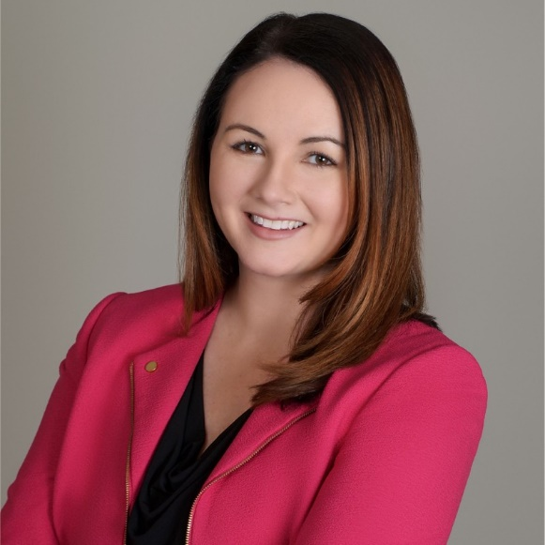
2023 Meetings
Hybrid quarterly meetings to continue, registration links on LIHC website
    Thursday, June 29, 2023 at 9:30 AM
    Thursday, September 28, 2023 at 9:30 AM
    Thursday, December 7, 2023 at 9:30 AM
June LIHC Meeting featuring Sarah Ravenhall, MHA, CHES
Executive Director of the New York State Association of County Health Officials (NYSACHO) and former Program Manager at the Long Island Health Collaborative! Ms. Ravenhall was named one of the top health powers in New York State in 2021 and named to the 2021 Albany 40 Under 40, both by City and State NY

Slide 13

Discussion

Slide 14
Adjournment
Thank you!
www.lihealthcollab.org
(631) 963-4167
lihc@nshc.org

